Slide 1

HI6050 Capstone: Comprehensive Topic Selection and Supplementary Document
Supervisor: Dr. Farshid Keivanian
Week 8: Data Collection Progress & Meeting 3

Slide 2
Session 8’s outline
Data Collection Progress & Meeting 3
Build and Export a Wireframe in Micro
2. Setting Up InVision Studio 2018 or newer
3. Why Track Weekly Progress in IT Projects?
4. Key Steps in Weekly Progress Tracking
Tools for Monitoring Progress
Trello / Asana: Task Management
Jira: Agile Project Tracking
Google Sheets: Progress Tracking and Reporting
Slack / Microsoft Teams: Communication and Quick Updates
Key Tips for Using These Tools Together
Additional Tips for You Working on Your Project
General Advice for All Projects
Components of an Effective Weekly Update
Group Progress Presentation – Overview of Progress at least 2 min

Slide 3
Data Collection Progress & Meeting 3
(Meeting window: Wk 8–9) Objectives:
Conduct Meeting 3.
Begin or continue data collection.
Ensure literature review supports analysis plan.
Share initial data analysis or raw dataset with supervisor.

Slide 4
Data Collection Progress & Meeting 3
Tasks:
In Meeting 3, present how your literature review supports your choice of analysis tools.
Present early findings or summary stats.
Discuss data issues (quality, gaps).
Update literature review if new insights arise.

Slide 5
Data Collection Progress & Meeting 3
Literature Link This Week:
If using surveys → cite validated survey instruments from literature.
If doing experiments → reference similar designs in past research.

Slide 6
Data Collection Progress & Meeting 3
Do’s:
Have visuals ready (graphs/tables).
Ask for advice on analysis techniques.
Don’ts:
Don’t ignore anomalies in data.
Avoid continuing flawed data collection.

Slide 7
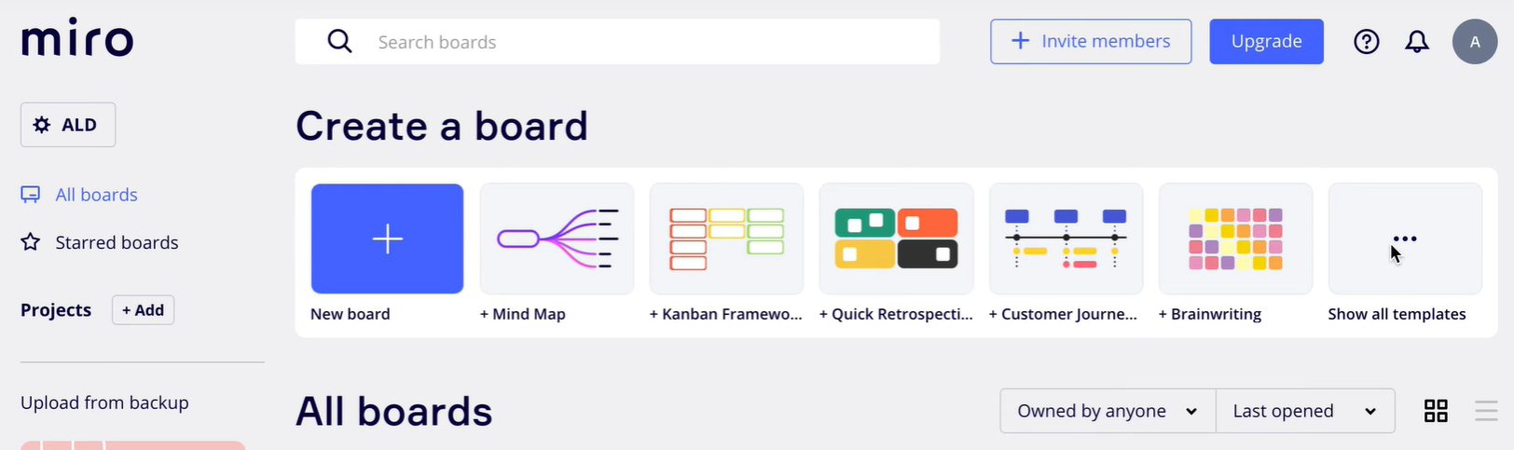
How to Build and Export a Wireframe in Miro: A Step-by-Step Guide
Step 1: Access Miro Templates
Navigate to Miro Dashboard.
Click "Show All Templates" on the main dashboard to explore available templates.

Slide 8
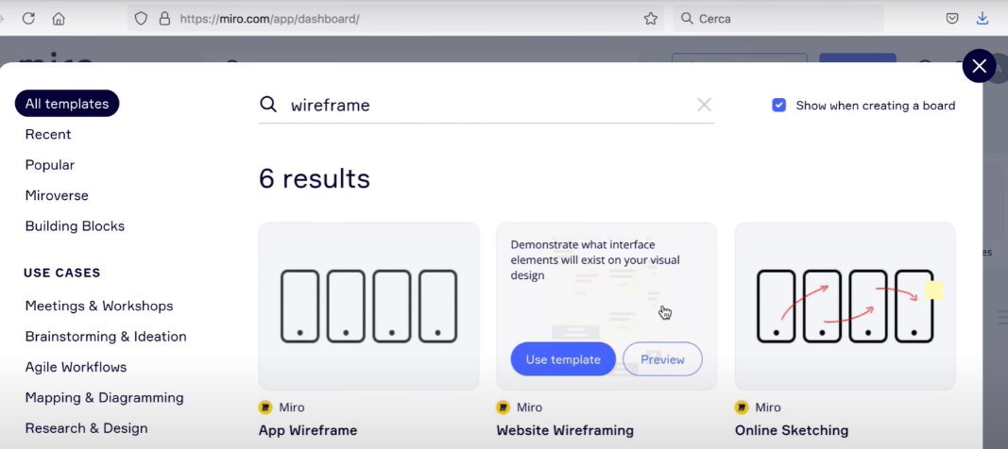
How to Build and Export a Wireframe in Miro: A Step-by-Step Guide
Step 2: Search for Wireframe Templates
Use the search bar within the template selection panel and type "wireframe".
Review the results for various wireframe templates tailored for app, website, or generic sketching needs.
Select the template you wish to use (e.g., "Website Wireframing").

Slide 9
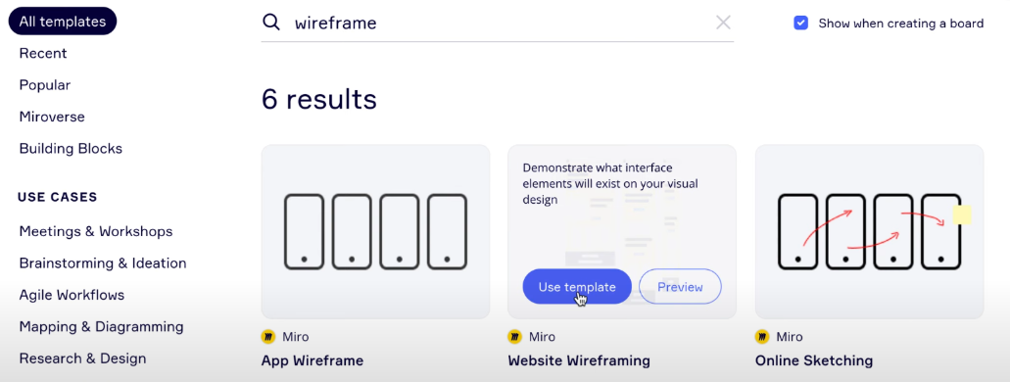
How to Build and Export a Wireframe in Miro: A Step-by-Step Guide
Step 3: Choose and Apply a Template
Click on "Use Template" to start editing the wireframe.
Miro will open the selected template on a new board.

Slide 10
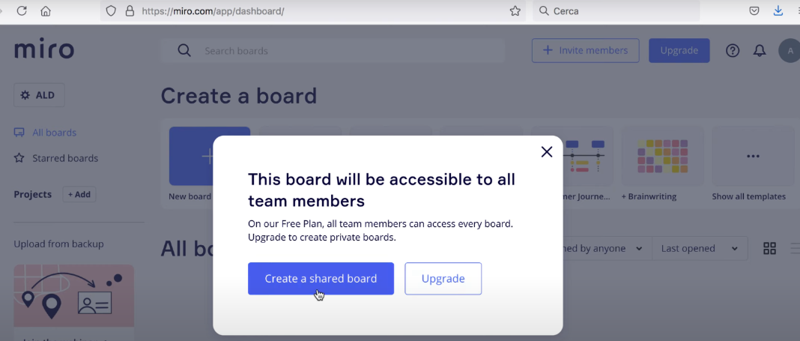
How to Build and Export a Wireframe in Miro: A Step-by-Step Guide
Step 4: Create a Shared Board
Upon starting the template, you might see a dialog prompting you to create a shared board.
Click "Create a Shared Board" (note: shared boards are accessible to all team members on the Free Plan).

Slide 11
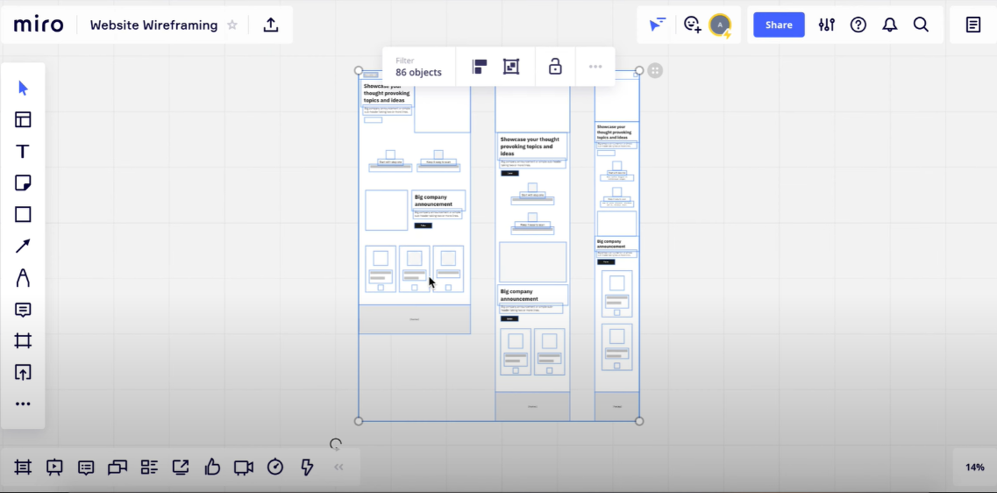
How to Build and Export a Wireframe in Miro: A Step-by-Step Guide
Step 5: Navigate and Zoom
Use the zoom controls on the right or your mouse/trackpad to zoom in and out of the wireframe.
Explore different sections or elements of the wireframe.

Slide 12
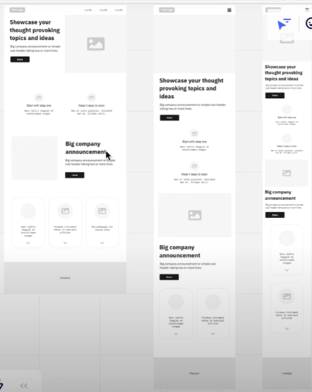
How to Build and Export a Wireframe in Miro: A Step-by-Step Guide
Step 6: Work Across Multiple Device Frames
Many templates include pre-made layouts for desktop, tablet, and smartphone.
Identify the section for the desired device frame (e.g., the left for desktop, the center for tablet, and the right for smartphone).

Slide 13
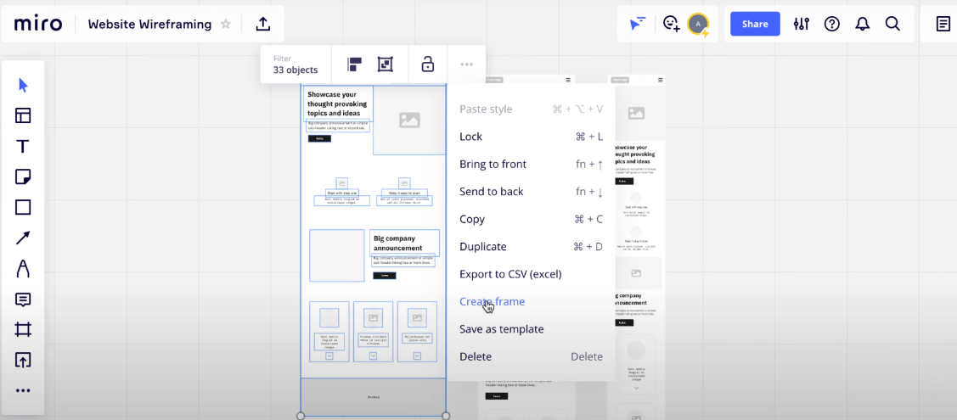
How to Build and Export a Wireframe in Miro: A Step-by-Step Guide
Step 7: Group and Create Frames
Select all objects for a device layout by dragging a selection box around them.
Click on the ellipsis menu ("..."), then choose "Create Frame".
Rename the frame (e.g., "Desktop") by selecting the frame and editing its title in the bottom-left panel.

Slide 14
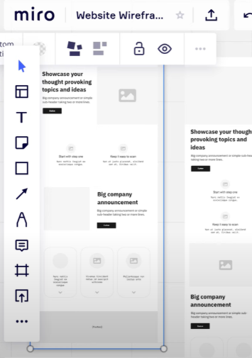
How to Build and Export a Wireframe in Miro: A Step-by-Step Guide
Step 8: Customize Individual Elements
Select any element within the frame (e.g., text, buttons, shapes).
Perform the following:
Move: Drag elements to reposition.
Resize: Drag the corners to adjust the size.
Delete: Select the element and press "Delete" or use the Delete option from the menu.
Edit Text: Insert text, adjust font size, make it bold, or customize its properties via the text editing toolbar.

Slide 15
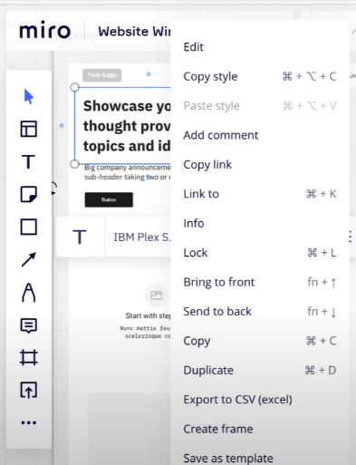
How to Build and Export a Wireframe in Miro: A Step-by-Step Guide
Step 9: Fine-Tune and Share
Customize the wireframe by adjusting design elements and aligning them to your goals.
Share your board with teammates by clicking the "Share" button at the top right and configuring access permissions.

Slide 16
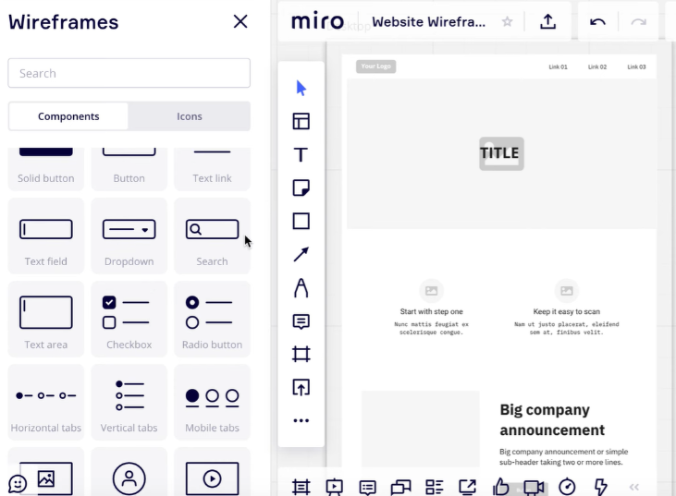
How to Build and Export a Wireframe in Miro: A Step-by-Step Guide
Step 10: Add Components to Your Wireframe
Open the "Wireframes" panel on the left-hand side.
Select desired components such as a search bar, buttons, text fields, or other UI elements.
Drag and drop the chosen components onto the wireframe.
Customize these components by resizing, editing text, or repositioning as needed.

Slide 17
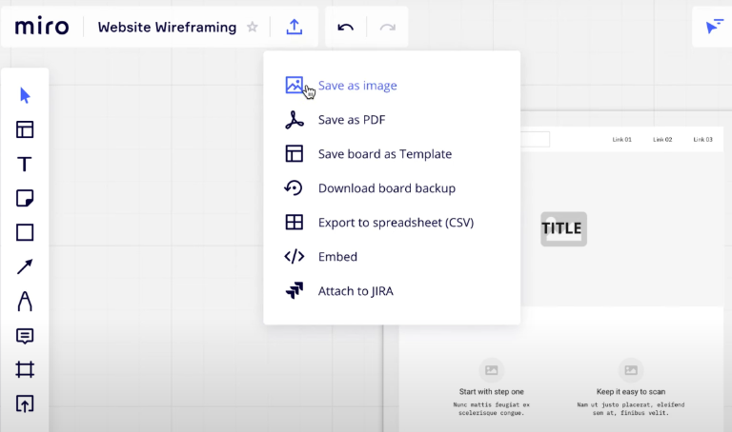
How to Build and Export a Wireframe in Miro: A Step-by-Step Guide
Step 11: Save and Export Your Wireframe
Once you’ve completed your wireframe, navigate to the top-right corner and click on the "Share" or menu options.
Select either:
"Save as Image" to download the wireframe as a PNG or JPEG file.
"Save as PDF" to export the wireframe in PDF format.
Choose the desired option, confirm settings, and download your file for sharing or further use.

Slide 18
How to Build and Export a Wireframe in Miro: A Step-by-Step Guide
This concludes the process for creating and exporting a wireframe using Miro. If you have any questions or need specific help with a feature, please feel free to ask!

Slide 19
Setting Up InVision Studio 2018 or newer
Download and Install: Ensure InVision Studio 2018 or newer is installed on your system.
Create a New Project: Start by clicking "New Project" and setting your artboard dimensions suitable for the intended platform (e.g., mobile, tablet, or desktop).
Understand the Interface: Familiarize yourself with the Layers Panel, Inspector Panel, and the Toolbar for managing components.

Slide 20
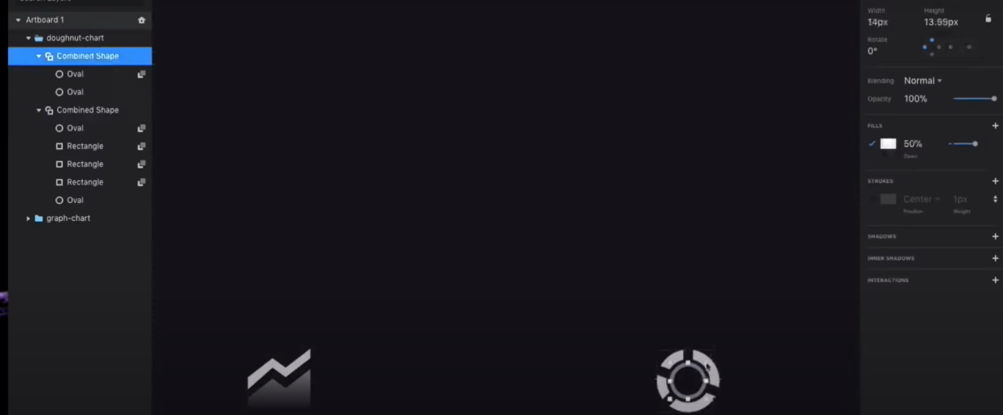
Designing the Dashboard Layout
Setting Up InVision Studio 2018 or newer
General Approach for All Projects:
Sketch the Layout:
Define the sections (e.g., navigation, charts, buttons).
Focus on user experience and ease of navigation.

Slide 21
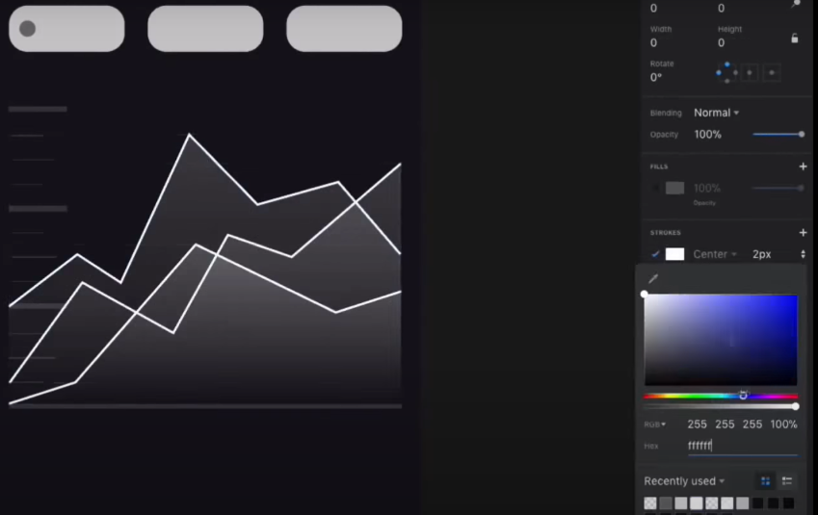
Designing the Dashboard Layout
Setting Up InVision Studio 2018 or newer
Use Artboards for Structure:
Create multiple artboards for different states/screens (e.g., dashboard, settings page, detail view).

Slide 22
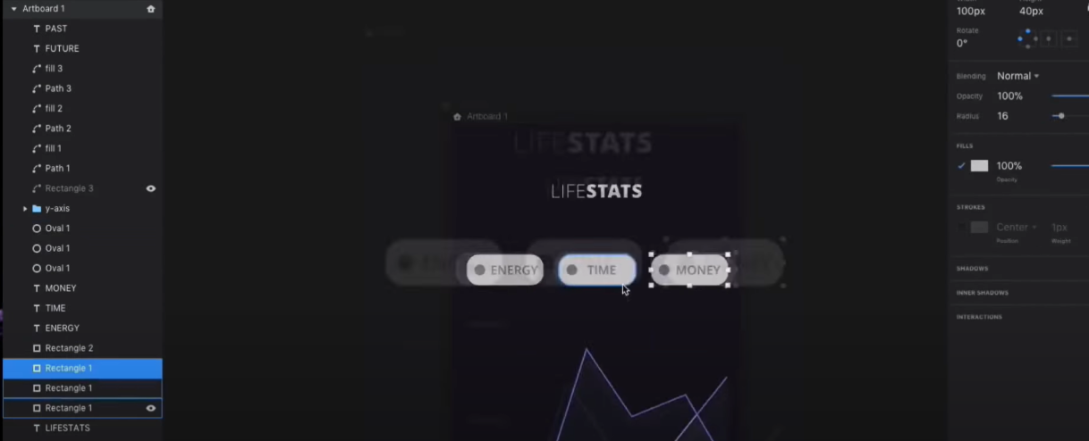
Designing the Dashboard Layout
Setting Up InVision Studio 2018 or newer
Design Hierarchical Layers:
Organize elements into groups like headers, buttons, charts, etc.

Slide 23
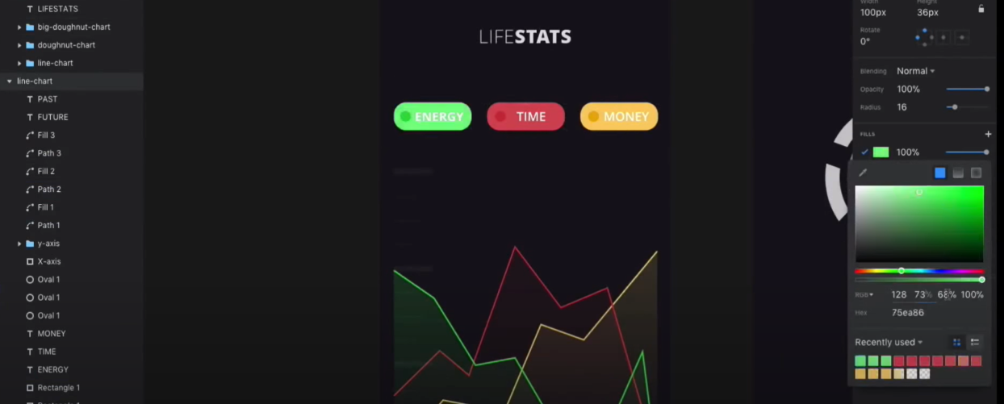
Project-Specific Considerations
Setting Up InVision Studio 2018 or newer
Restaurant Management System:
Add a sidebar for managing tables, orders, and staff.
Create dynamic visualizations for daily sales and occupancy.

Slide 24
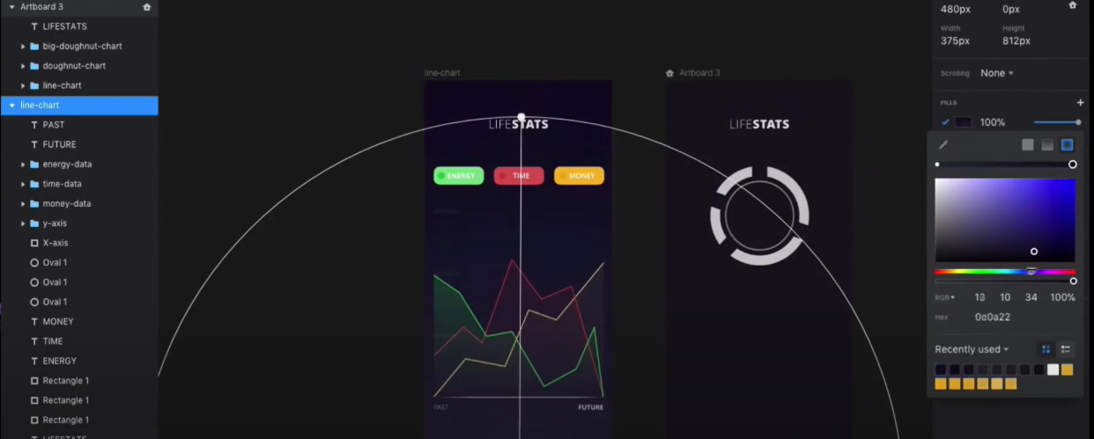
Project-Specific Considerations
Setting Up InVision Studio 2018 or newer
Fitness Tracker:
Include progress charts for calories burned, goals, and activities.
Use interactive toggles for switching between different metrics.

Slide 25
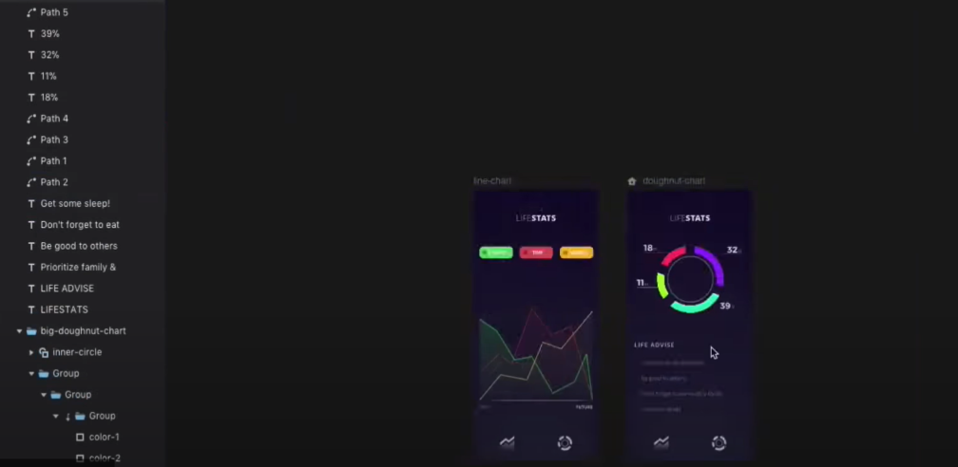
Project-Specific Considerations
Setting Up InVision Studio 2018 or newer
Study Planner:
Incorporate a task calendar, daily summary, and notification center.
Highlight overdue tasks and upcoming deadlines.

Slide 26
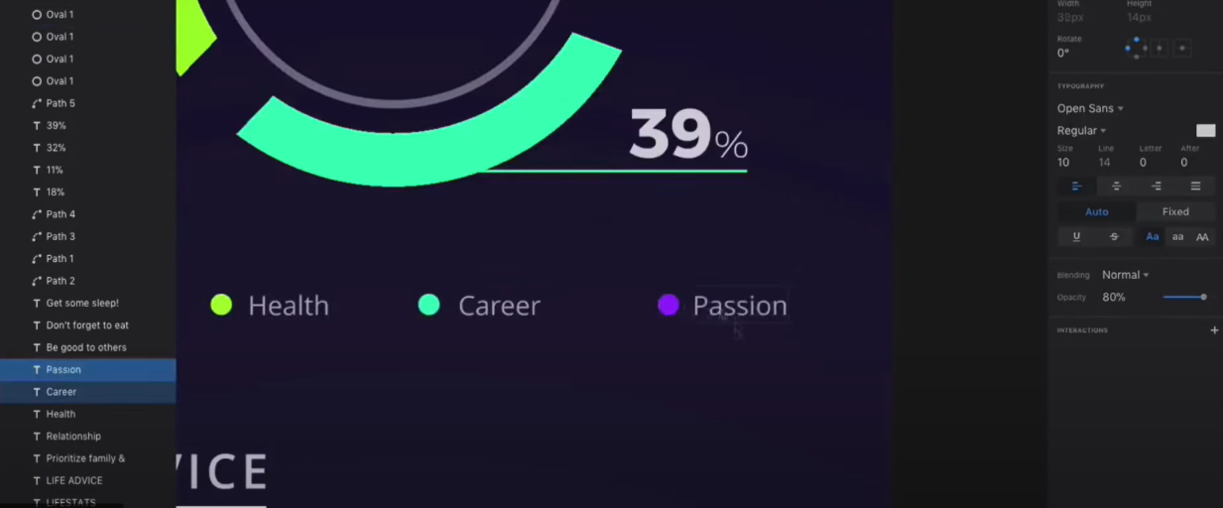
Project-Specific Considerations
Setting Up InVision Studio 2018 or newer
Retail Management:
Design a dashboard with product inventory levels, sales insights, and customer feedback.

Slide 27
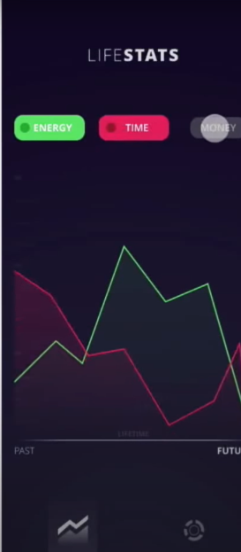
Adding Visual Elements
Setting Up InVision Studio 2018 or newer
Typography and Icons:
Use the Text Tool to create headings and labels.
Add icons (e.g., from Material Design or Font Awesome) for user-friendly navigation.

Slide 28
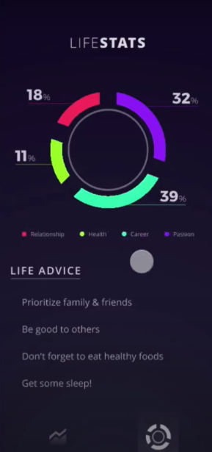
Adding Visual Elements
Setting Up InVision Studio 2018 or newer
Shapes and Components:
Use the Shape Tool (rectangle, oval, etc.) to design buttons and charts.
Combine shapes for custom graphics (e.g., pie charts or line graphs).

Slide 29
Adding Visual Elements
Setting Up InVision Studio 2018 or newer
Color and Style:
Use consistent colors for branding.
Apply gradients and shadows for a modern look.

Slide 30
Creating Interactive Components
Setting Up InVision Studio 2018 or newer
Add Buttons and Actions:
Create buttons for navigation and set interactions (e.g., hover or click).

Slide 31
Creating Interactive Components
Setting Up InVision Studio 2018 or newer
Animate Transitions:
Use the Prototype Mode to connect artboards.
Add animations (e.g., slide-in menus, fade-in charts).

Slide 32
Creating Interactive Components
Setting Up InVision Studio 2018 or newer
Dynamic Data Representation:
Use layered groups for data-driven visuals, like bar or doughnut charts.
Define states to toggle between data sets (e.g., energy, time, money for fitness).

Slide 33
Prototyping and Testing
Setting Up InVision Studio 2018 or newer
Link Screens:
Connect artboards to simulate user flow.
Test Responsiveness:
Preview the design on various devices (mobile, tablet, desktop).

Slide 34
Prototyping and Testing
Setting Up InVision Studio 2018 or newer
User Feedback:
Share prototypes with stakeholders for feedback using the Share Link feature.

Slide 35
Exporting and Finalizing
Setting Up InVision Studio 2018 or newer
Export Assets:
Use the Export panel to save designs as PNG, SVG, or other formats.

Slide 36
Exporting and Finalizing
Setting Up InVision Studio 2018 or newer
Prepare for Development:
Document interactions and transitions for developers.
Share the project file or a design system for consistency.

Slide 37
Examples for Inspiration
Setting Up InVision Studio 2018 or newer
Interactive Restaurant Management System:
Display orders dynamically with drag-and-drop features.
Add real-time kitchen status updates.

Slide 38
Examples for Inspiration
Setting Up InVision Studio 2018 or newer
Personalized Fitness Tracker:
Incorporate motivational progress bars and daily goals.

Slide 39
Examples for Inspiration
Setting Up InVision Studio 2018 or newer
Student Study Planner:
Highlight customizable task categories and completion statuses.

Slide 40
Examples for Inspiration
Setting Up InVision Studio 2018 or newer
Interactive Retail Management System:
Create filters for sorting inventory and visual analytics.

Slide 41
Why Track Weekly Progress in IT Projects?
Tracking weekly progress ensures alignment with project goals, early identification of challenges, and iterative improvements. It fosters accountability and efficient time management.

Slide 42
Key Steps in Weekly Progress Tracking
Set clear, measurable goals for the week.
Document accomplishments and challenges.
Conduct team meetings to discuss progress.
Adjust plans based on feedback and observations.

Slide 43
Tools for Monitoring Progress
Use tools like:
Trello or Asana: For task management.
Jira: For agile project tracking.
Google Sheets: For progress tracking and reporting.
Slack or Microsoft Teams: For communication and quick updates.

Slide 44
Trello / Asana: Task Management
Trello:
Create a Board: Start with a blank board and name it (e.g., "Project Dashboard Design").
Create Lists: Add lists for task stages like To Do, In Progress, and Completed.

Slide 45
Trello / Asana: Task Management
Add Cards: Break down tasks into cards (e.g., "Design wireframes", "Prototype animations").
Assign and Set Deadlines: Assign members, add checklists, and set due dates.
Power-Ups: Integrate tools like Google Drive or Slack for added functionality.

Slide 46
Trello / Asana: Task Management
Asana:
Create a Project: Choose a board, timeline, or list view for tasks.
Add Tasks: Enter tasks and subtasks, assign them to team members, and set due dates.

Slide 47
Trello / Asana: Task Management
Track Progress: Use the timeline view for scheduling or the calendar view for deadlines.
Custom Fields: Use custom fields to track priorities or task types.

Slide 48
Jira: Agile Project Tracking
Create a New Project:
Choose an Agile template (e.g., Scrum or Kanban).
Set Up the Backlog:
Add epics and stories (e.g., "User Login Feature" or "Design Dashboard Charts").

Slide 49
Jira: Agile Project Tracking
Sprint Planning (Scrum):
Drag backlog items into the sprint to be worked on.
Assign story points and team members.
Track Work:
Use the Kanban Board or Active Sprint Board to track task progress (e.g., To Do, In Progress, Done).

Slide 50
Jira: Agile Project Tracking
Reporting:
Use burndown charts, velocity charts, and issue types for tracking sprint success.

Slide 51
Google Sheets: Progress Tracking and Reporting
Set Up a Sheet:
Create columns like Task, Assigned To, Status, Start Date, Due Date, and Comments.

Slide 52
Google Sheets: Progress Tracking and Reporting
Color Coding:
Use conditional formatting to highlight task statuses (e.g., green for complete, yellow for in progress).

Slide 53
Google Sheets: Progress Tracking and Reporting
Track Progress:
Update task status regularly and monitor deadlines using filters.

Slide 54
Google Sheets: Progress Tracking and Reporting
Generate Reports:
Use pivot tables or graphs for visualizing task completion and team productivity.

Slide 55
Google Sheets: Progress Tracking and Reporting
Share and Collaborate:
Share the sheet with team members and enable commenting.

Slide 56
Slack / Microsoft Teams: Communication and Quick Updates
Slack:
Create Channels:
Create channels for specific topics (e.g., #design-team, #project-updates).
Integrations:
Connect apps like Trello, Jira, or Google Drive for instant updates.

Slide 57
Slack / Microsoft Teams: Communication and Quick Updates
Direct Messaging:
Use private or group messaging for quick communication.
Pinned Messages and Files:
Pin important messages or files for easy reference.

Slide 58
Slack / Microsoft Teams: Communication and Quick Updates
Microsoft Teams:
Create Teams and Channels:
Set up a Team and channels for different aspects of the project (e.g., Design, Development).

Slide 59
Slack / Microsoft Teams: Communication and Quick Updates
Share Files:
Upload documents directly into channels for collaboration.
Meetings and Updates:
Use the Calendar to schedule meetings and the Posts tab for updates.

Slide 60
Slack / Microsoft Teams: Communication and Quick Updates
Integrations:
Add tools like Planner or integrate apps like Jira or Trello

Slide 61
Key Tips for Using These Tools Together
Centralized Communication: Use Slack or Teams for announcements and quick updates.
Task Assignment: Use Trello/Asana for assigning and managing tasks.

Slide 62
Key Tips for Using These Tools Together
Progress Reporting: Track progress in Google Sheets and share reports weekly.
Agile Planning: Use Jira for sprints and detailed task tracking.

Slide 63
Additional Tips for You Working on Your Project
1. Interactive Restaurant Management System
Trello/Asana: Use a dedicated list for each aspect of the system (e.g., Menu Management, Order Tracking, Table Reservations).
Jira: Track development of specific features like real-time order updates or staff assignments in sprints.

Slide 64
Additional Tips for You Working on Your Project
Google Sheets: Maintain a mock "order log" or "sales tracker" to simulate real-time reporting for the system.
Slack/Teams: Use for quick updates on menu design or integration with point-of-sale systems.

Slide 65
Additional Tips for You Working on Your Project
Personalized Fitness Tracker
Trello/Asana: Break down tasks into modules like Activity Logging, Goal Tracking, and Progress Reports.
Jira: Use epics for user interface design, API integration, and real-time data tracking.

Slide 66
Additional Tips for You Working on Your Project
Google Sheets: Simulate data input (e.g., daily calories, steps) and visualize user progress through charts.
Slack/Teams: Discuss real-time user feedback or updates on integrating wearable devices (e.g., Fitbit, Apple Watch).

Slide 67
Additional Tips for You Working on Your Project
3. Student Study Planner and Task Organizer
Trello/Asana: Create lists for daily, weekly, and monthly tasks, adding deadlines and priorities.
Jira: Plan user-friendly features like reminders, calendar integrations, and task categorization in sprints.

Slide 68
Additional Tips for You Working on Your Project
Google Sheets: Develop a progress tracker to calculate task completion rates or overdue assignments.
Slack/Teams: Use notifications to brainstorm about UI/UX improvements and test scheduling algorithms.

Slide 69
Additional Tips for You Working on Your Project
4. Interactive Retail Management System
Trello/Asana: Manage categories like Inventory, Sales Tracking, and Customer Engagement.
Jira: Focus on agile development for features like inventory alerts or customer order history.

Slide 70
Additional Tips for You Working on Your Project
Google Sheets: Simulate inventory data and visualize sales trends with pivot tables and charts.
Slack/Teams: Collaborate on designing dashboards for store managers or real-time sales analytics.

Slide 71
General Advice for All Projects
Iterate with Feedback: Share your prototypes with peers, tutors, or industry professionals for feedback.
Focus on User Experience: Prioritize clean design and intuitive navigation for dashboards and user interfaces.

Slide 72
General Advice for All Projects
Document the Process: Maintain clear documentation of your progress, including tool usage and feature development.
Integrate Tools: Leverage integrations (e.g., Trello with Slack, Google Sheets with Jira) for a smoother workflow.

Slide 73
General Advice for All Projects
Remember, the goal is not just to complete the project but to create a functional, user-friendly system that aligns with real-world requirements. Best of luck!

Slide 74
Components of an Effective Weekly Update
Each update should include:
Completed tasks.
Ongoing activities.
Challenges faced and solutions proposed.
Plans for the upcoming week.

Slide 75
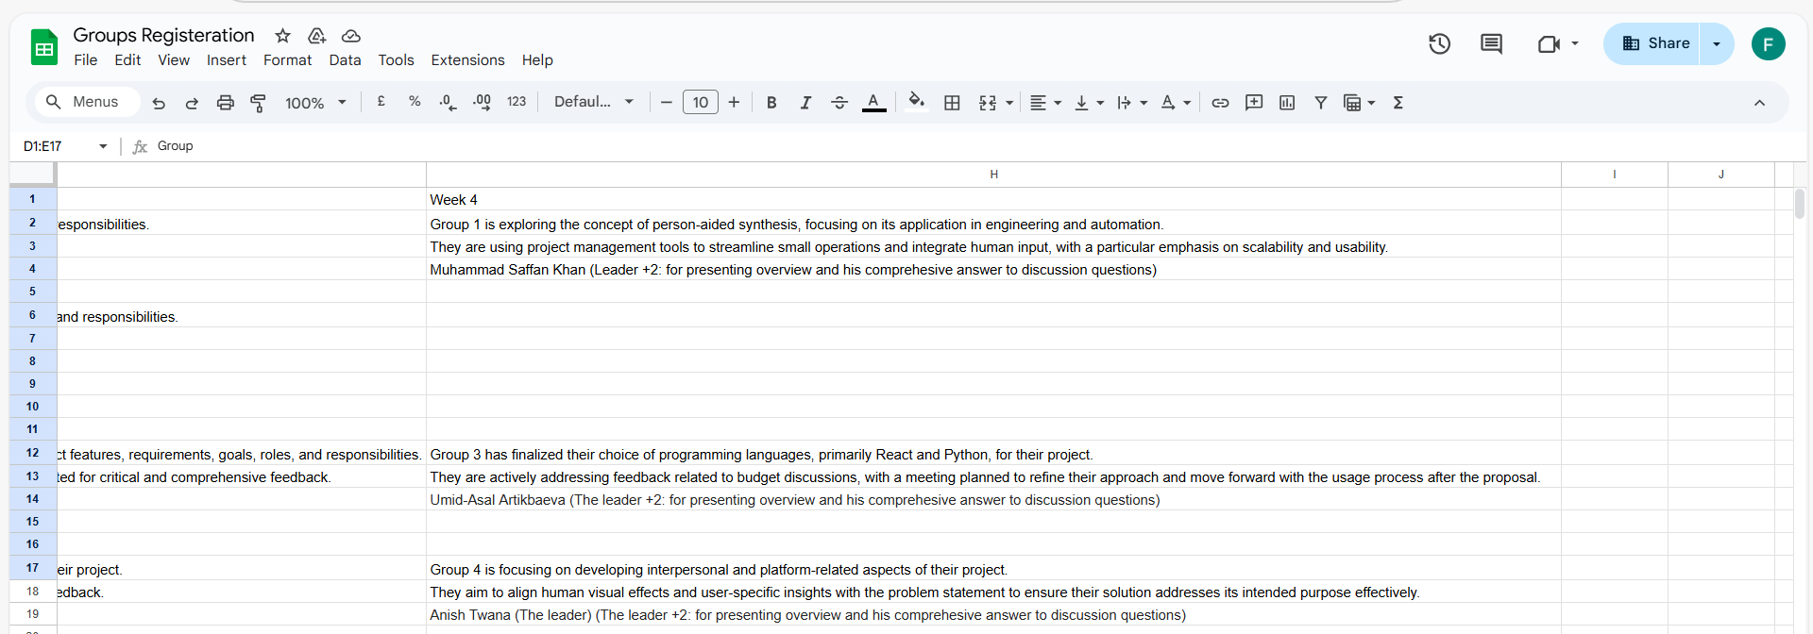
Group Progress Presentation – Overview of Progress at least 5 min

Slide 76
Thank You
Need Help? Send an email or ask during the tutorial session.
Good luck with your capstone journey!
Dr. Farshid Keivanian Capstone Project Supervisor FKeivanian@my.holmes.edu.au

